Slide 1

CS 470 Project Two Conference Presentation: Cloud Development
Justin Chevalier
February 2024
Notes:
Hey everyone, my name is Justin Chevalier and I’m a senior at Southern New Hampshire University. I’m currently taking my final class to obtain my bachelor’ s degree in software engineering. I will be presenting a presentation about cloud development in the application we built that was featured in the Full Stack Development II course. Let’s get started!

Slide 2
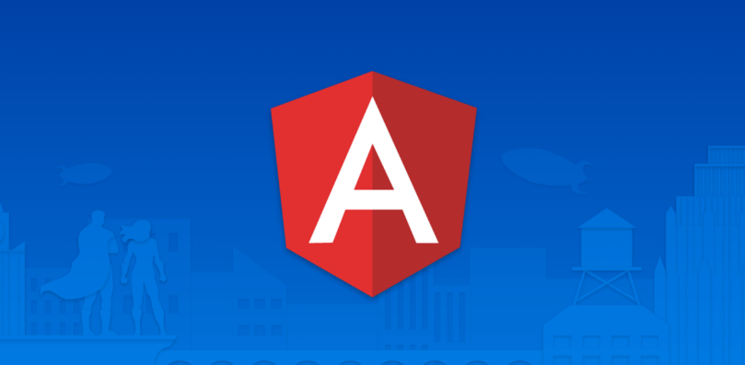

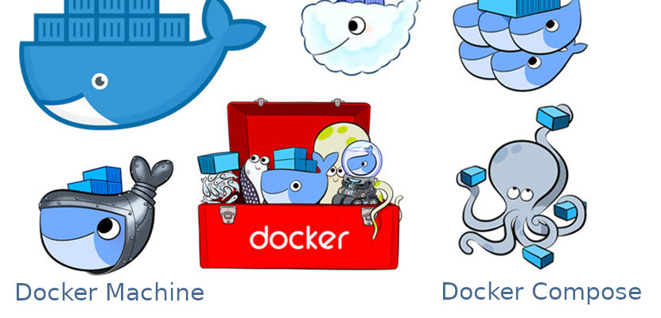

Overview
Notes:
In this presentation I’ll be giving an in-depth overview of how we migrated a full stack web application into a cloud-based web application with assistance from the Amazon Web Services. We utilized various Amazon Web services which featured DynamoDB as our database. We also used the API Gateway to make API calls as well as Lambda and the S3 buckets. Our initial development included the use of Angular for the front end of the application, the MEAN stack API and MongoDB with Docker to house our application in containers. The cloud services provided by AWS enabled us to deploy web services from a local host into a cloud base service which enabled us to work remotely. It also enhanced security features of the application, which allowed us to store a significant amount of data and cut the cost of development with the pay as you go feature.

Slide 3
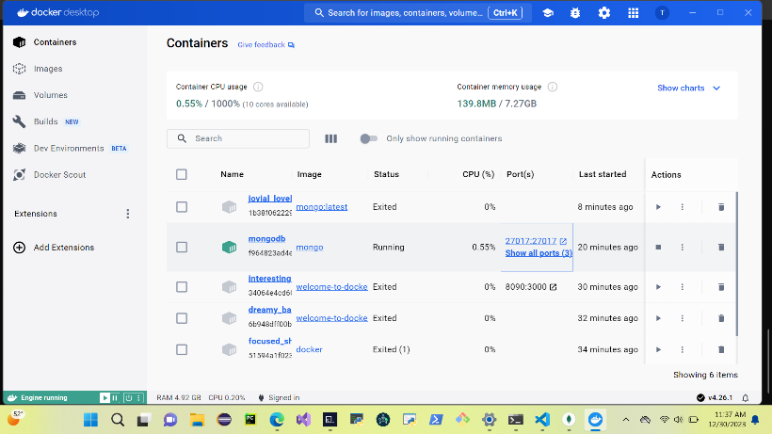
Containerization
Runs faster and more reliably
Uses only needed libraries and dependencies
Moves the application and its data from local host to the cloud
Can run multiple applications on a single host
Notes:
This process involved the use of an Angular application that was migrated onto the Amazon Web Services. We first prepared the Angular application by implementing containers. By using the containers, this will enable the application to properly function and therefore the runtime environment can be transferred. We utilize the Docker Desktop application which features Docker Compose and MongoDB to implement a shared network that our application can function within. This is essential for containerization and to ensure that the software will still function when relocated from different environments. As a result, the containers will house the integrated environment of our application.

Slide 4
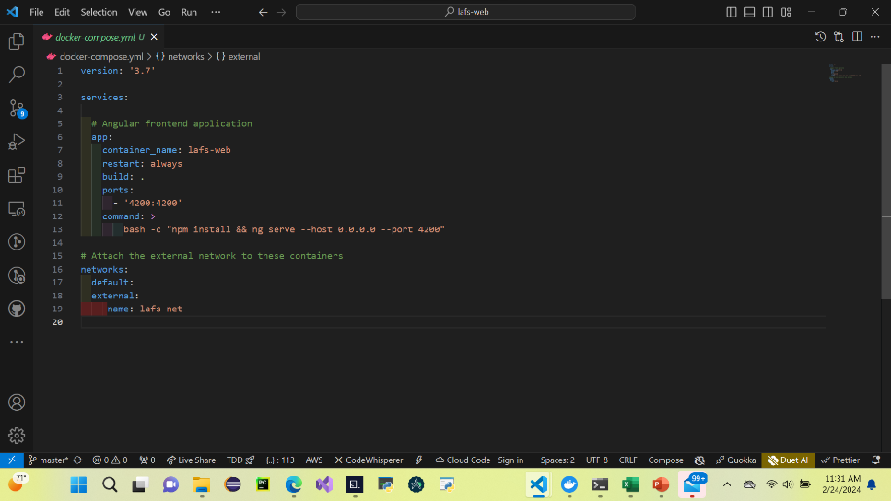
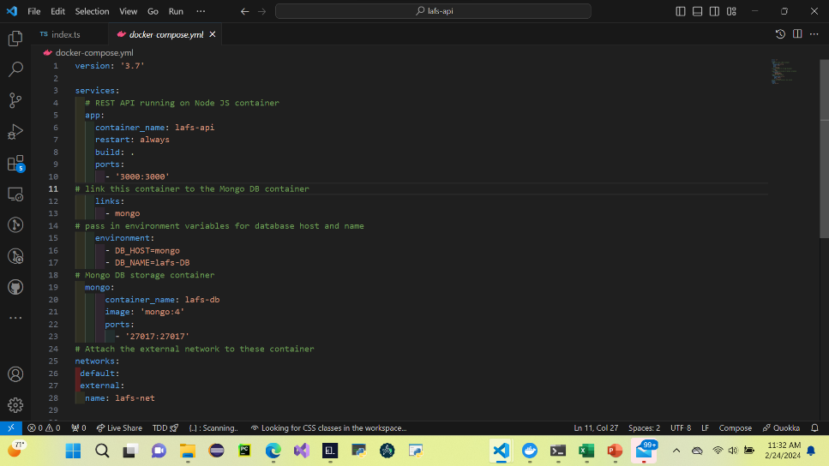
Orchestration
Docker Compose for the Front End
Docker Compose for the Back End
Notes:
When we finish formulating the files and migrating them into the database, we finally must bring it all together. Docker Compose is a vital tool for accomplishing this feat. With the help of Docker containers where our data is located, we can now construct a bridge network in which the containers can start communicating with other containers. We utilize two different docker compose yaml files to make this possible. We implemented a docker yaml file for communicating to the angular frontend and we also had a docker yaml file to access the backend which features MongoDB. Once the application is up and running efficiently, we progressed to the next step which is deploying it into the cloud.

Slide 5
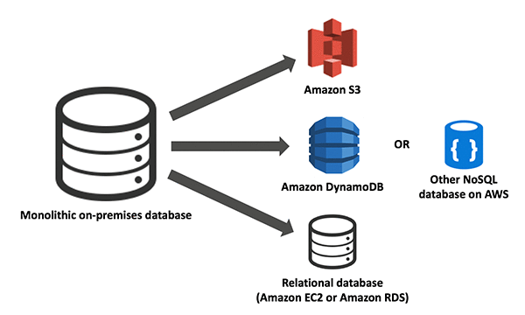
The Serverless Cloud
Serverless
Don’t have to maintain servers
High scalability and great security
Pay as you go subscription based cloud storage
AWS S3 Cloud Storage
Data is backed up and stored for the protection of data and easily retrievable
This Photo by Unknown Author is licensed under CC BY-NC
Notes:
The serverless cloud enables us to deploy the application without the physical presence of a server. The concept of a serverless cloud is not truly serverless because its managed by a larger data service such as the Amazon S3. This concept allows us to save time and money by storing our data using the Amazon S3 buckets which offers different storage amounts based on our storage needs. If you would rely on local hardware for storage there would be limits on the storage capabilities. While an internet connection wouldn’t be needed to accommodate local storage, the AWS cloud assure that the data is backed up and copied to ensure that your data is not lost and can be easily restored.

Slide 6
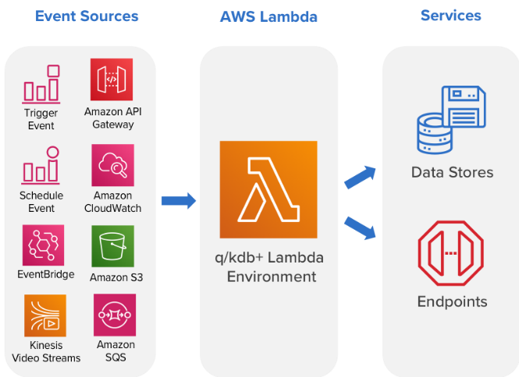
The Serverless Cloud
API & Lambda
Event driven
Simple API integration
Only pay when used
Highly scalable
Builds REST API’s and integrates them with Lambda functions
This Photo by Unknown Author is licensed under CC BY
Notes:
When using the Amazon Web Services we can design our REST API’s using Lambda functions. Lambda functions are utilized like function when coding but with AWS we don’t have to implement the function for the code. The lambda functions run with the java script file and these functions are tested via a JSON file. Once the lambda function are initiated, we can focus on building our API for the functions we have designed can communicate with the database to execute tasks. These tasks usually involve creating, reading, updating, and deleting data. This is also known as the CRUD operations. As soon as we have our API’s up and running permissions must be requested to utilize the lambda functions that were created. This will enable us to transmit and transfer the data.

Slide 7
The Serverless Cloud
Database
MongoDB
Document based NoSQL database that stores unstructured data
It uses key value pairs
DynamoDB
NoSQL database that uses a single table design to ensure quick read and transfer of data
Notes:
After creating the lambda functions and the API’s are integrated, there was a need to create a database for the questions and answers portion of our project. We utilize MongoDB for our database which is a no SQL database. MongoDB is an open source document based database that provides users with great flexibility in storing data. It uses key value pairs as a collection in which the key serves as its unique identifier. Amazon Web Services offer its own version of a no SQL database which is called DynamoDB. DynamoDB incorporates all of AWS services and takes advantage of the tools provides by Amazon. With its single table design, this feature enables DynamoDB to share the primary key as well as the sort key which allows data to be accessed quickly and maximizes its performance.

Slide 8
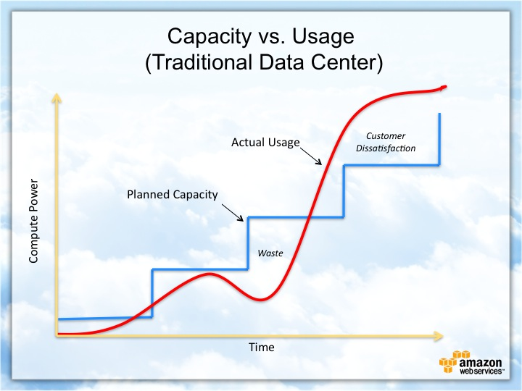
Cloud-Based Development Principles
Elasticity
Pay-for-use model
Notes:
While developing an application the cost can get very expensive but when using AWS and its pay for use model you can efficiently decrease the cost because you only pay for what you use. The AWS model scales to accommodate for how much the users need by increasing and decreasing based on your needs. When using local storage users may have to purchase additional hardware such as servers, hard drives, and computers to provide increased storage options. AWS presents users with flexibility with storing their data and can be very cost efficient.

Slide 9
Securing Your Cloud App
Access
Policies
API Security
IAM Roles
Permissions Policies
Assign policies to roles
Create custom policies as needed
CRUD functionality with DynamoDB
API Keys
Data Encryption
Private Object Buckets
Notes:
The cloud features enhanced security to prevent unauthorized users from scrutinizing with the application. With the help of the IAM roles and policies we can filter certain permissions. For example within our project we created a custom policy that limit the functionality between the lambda functions and the DynamoDB database to only allow the CRUD functions which are create, read, update, and delete within the application. These are several types of security features within the AWS ecosystem such as using API keys to perform calls that send and receive data. Firewalls are also present that can decline any unwanted data by screening HTTP request.

Slide 10
Conclusion
Easy Development
Cost efficient
Pay for use model
Flexibility
Thank you for your time.
Notes:
My main takeaways from executing this project from a local environment to a cloud environment is that the cloud allows our be to be efficiently scalable and very cost effective. Using the AWS such as API Gateway and Lambda functions made each step of the progress easy and enjoyable. With minimal resources needed to develop the application this allowed us to use our time more wisely and give us freedom to explore different aspect of the applications. Thank you for your time and have a wonderful day.

